Slide 1
Watersheds
What are they?
and
Why Should I Care?

Slide 2
What is a Watershed?
An area of land that drains water, sediment, and pollutants into a common body of water.
Watersheds are separated by higher land areas called divides (mountains, ridges, etc.).

Slide 3
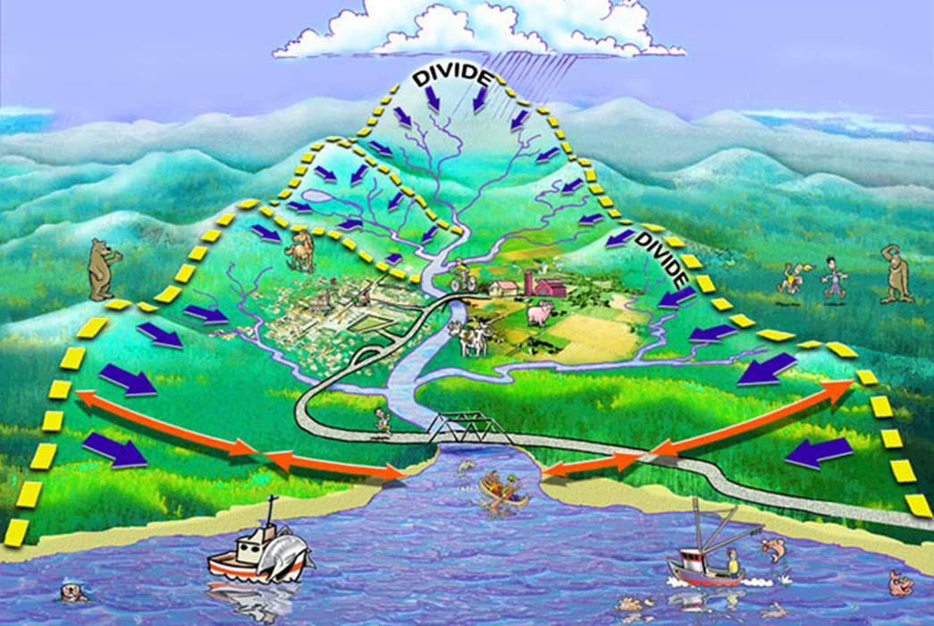

Slide 4

A Nested System
Watersheds are also like Russian Matryoshka or nesting dolls. Larger watersheds contain smaller watersheds, which contain even smaller ones.

Slide 5
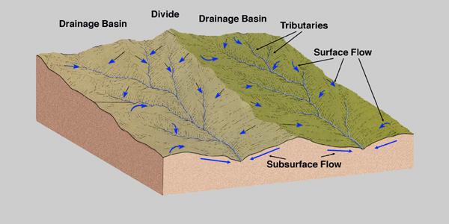
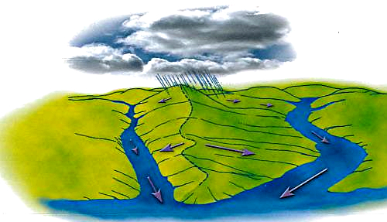
A Divide separates two watersheds

Slide 6
Water in a Watershed
Within a watershed, precipitation collects and drains into a river, lake, stream, or the ocean
GROUNDWATER and SURFACE WATER both contribute to the water in a watershed

Slide 7
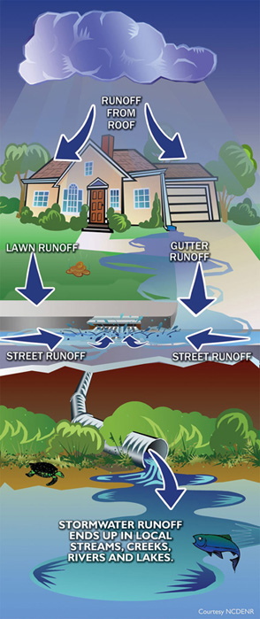
Watersheds collect RunOff

Slide 8
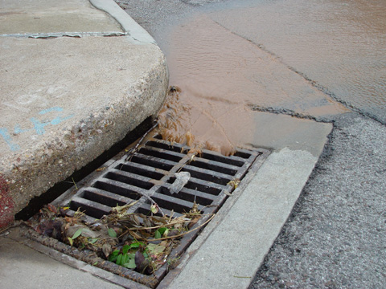
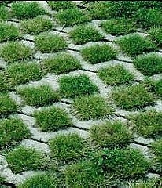
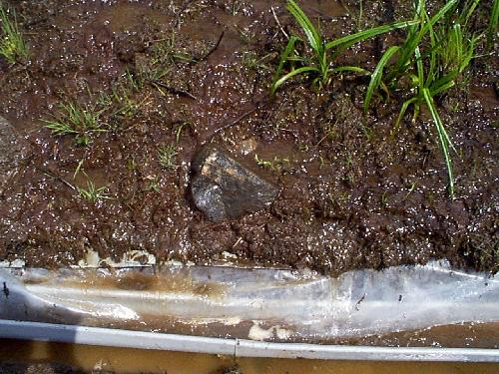
Factors Affecting Runoff - Space
The amount of space between particles of dirt, soil & rock.
(Pavement doesn’t allow runoff
to soak into the ground.)
Porous
Pervious
Impervious
Permeable
Impermeable

Slide 9
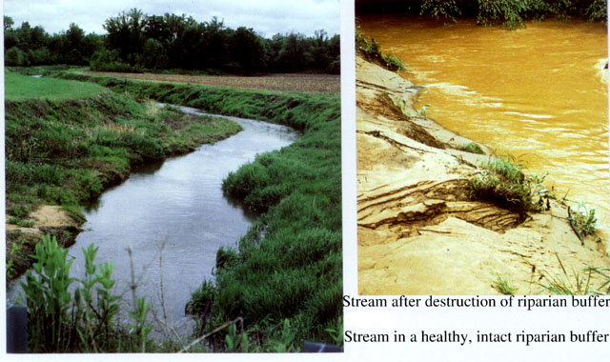
Factors affecting RunOff - Buffers

Slide 10
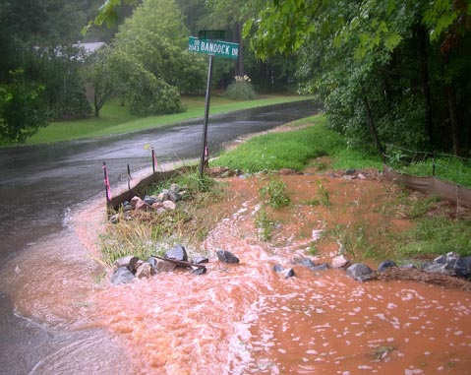
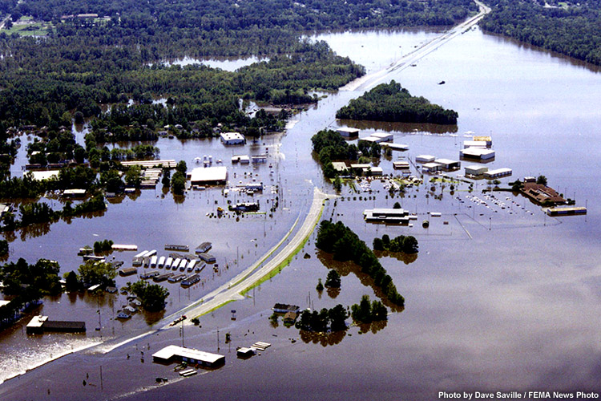
Factors affecting Runoff – Amount
(A large amount of rainfall over a short amount of time)

Slide 11
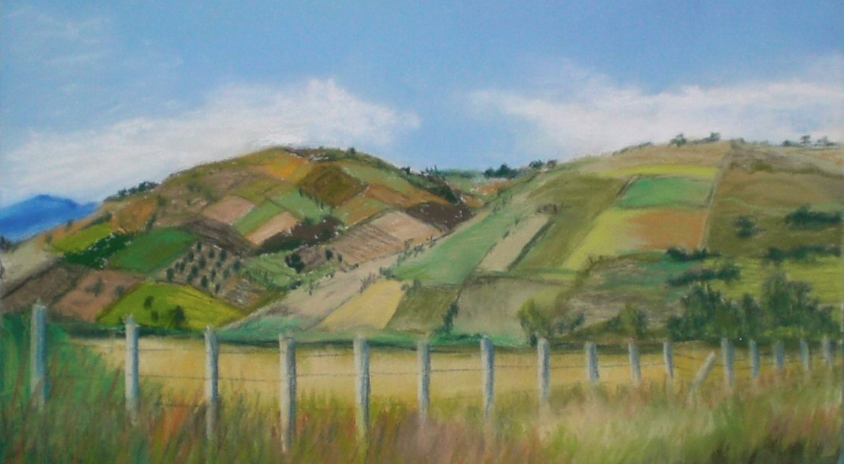
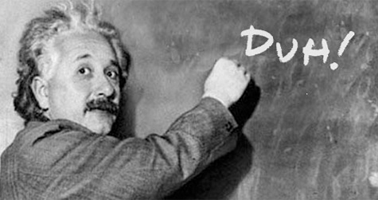
Factors affecting RunOff – Gravity
Water moves from
Higher elevations to Lower elevations

Slide 12
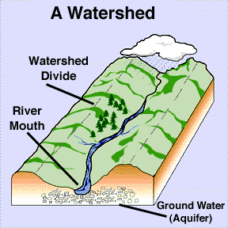
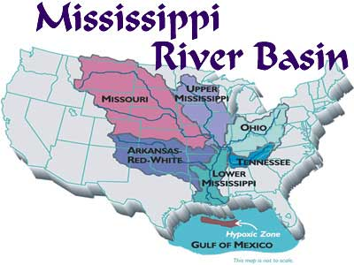
What is the difference between a watershed and a river basin?
  Both terms describe land that drains into a river, stream or lake

Slide 13
Watershed vs River Basin
  Both terms describe land that drains into a river, stream or lake, but…
    River Basin: drains into a large river (bigger)
    Watershed: drains into a smaller river or stream

Slide 14
From Watershed to
River Basin
Larger river basins are made up of many interconnected watersheds
  Example: Cape Fear and Neuse River Basins are made of many small watersheds
The water in a watershed runs to the lowest point—a river, stream, lake, or the ocean

Slide 15
Rivers, Lakes, and Streams
What is a river?
  A large channel along which water is continually flowing down a slope—made of many streams that come together
What is a stream?
  A small channel along which water is continually flowing down a slope—made of small gullies
What is a lake?
  A body of water of considerable size contained on a body of land

Slide 16
Lakes
Natural lakes – a low area of land where surface water runoff accumulates
The largest natural lake in NC is Lake Mattamuskeet
Artificial lakes – can be created by building a dam across a river.
The largest artificial lake in NC is Lake Norman

Slide 17
Checkpoint!
What is the difference between a river and a stream?
What is a watershed?
What can affect RunOff in a Watershed?
What is the difference between a watershed and a river basin?
BONUS: What is a tributary?

Slide 18
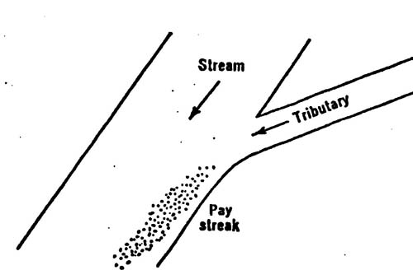
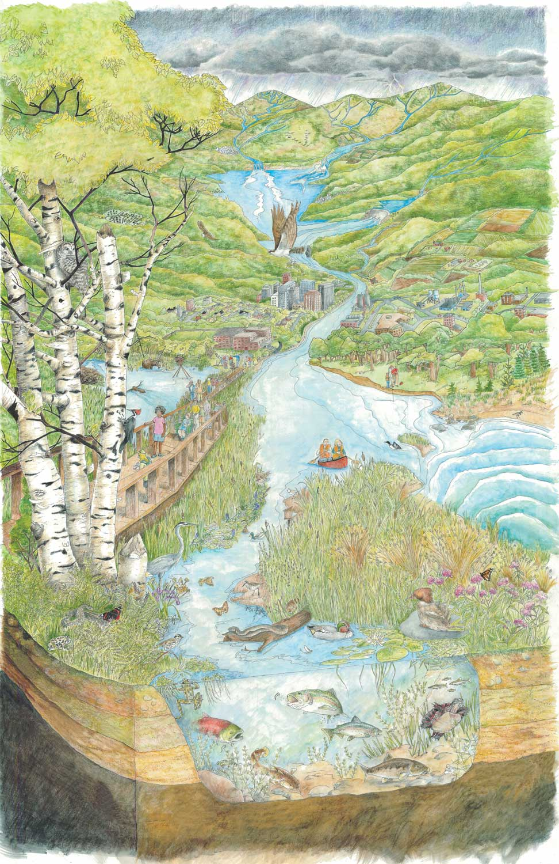
Tributaries: Smaller streams and rivers that feed a main river.
  A river and its tributaries make up a river system.

Slide 19
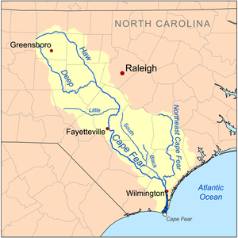

Slide 20
Video
http://www.youtube.com/watch?v=1cEPz5qNLyg

Slide 21
Watershed must include
4 tributaries
1 main river
Ocean at the base
Farm – with animals and crops
Drinking pond near farm
Housing area
Mountains at top
Wetland near ocean
Buffers will be added during experiment

Slide 22
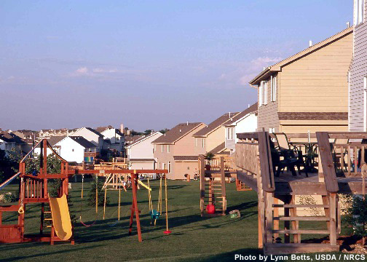
Your own backyard is part of a Watershed!

Slide 23
POLLUTION
Pollutants
Point-Source Pollution
Non-Point-Source Pollution

Slide 24
Weather & Watersheds: Rain
What is the most common cause of pollution in streams, rivers, and oceans?
Dumping of garbage by cities
Surface water running off yards,
streets, paved lots, and farm fields
Trash washed into the ocean
from beaches
Waste dumped by factories

Slide 25
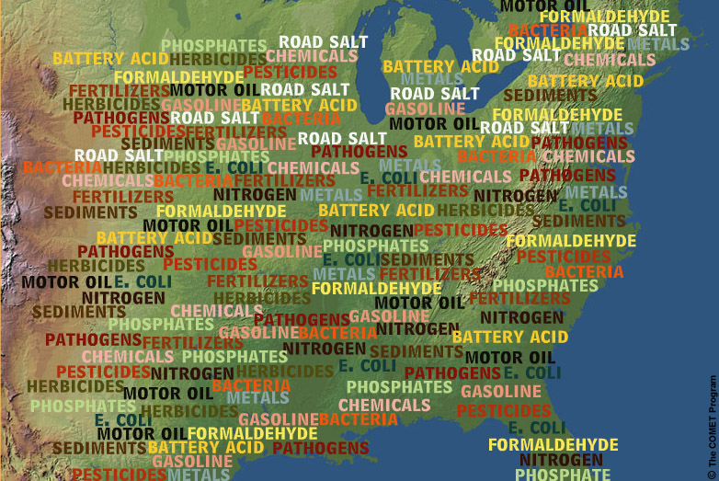
Pollutants are any substances that can harm the environment
Precipitation runoff from farms, lawns, and paved surfaces is the leading source of water pollution in America today.

Slide 26
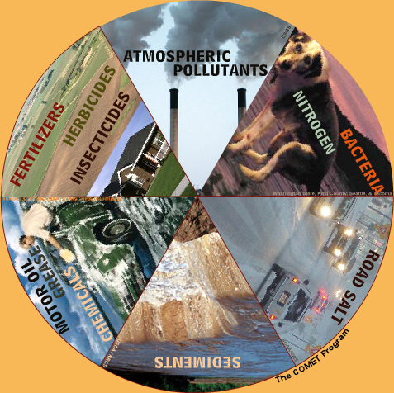
What’s in the water?
Main pollutants:
Fertilizers
Herbicides
Insecticides
Oil, grease, and
toxic chemicals
from urban areas
Sediment
Road Salt
Bacteria and
Nitrogen
Air pollutants

Slide 27
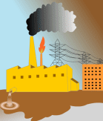
Pollution in our Watershed
Point Source pollution
Point source pollution comes from a definite source:
  Factories
  Refineries
  Municipal Facility
    Sewage Treatment Plant

Slide 28
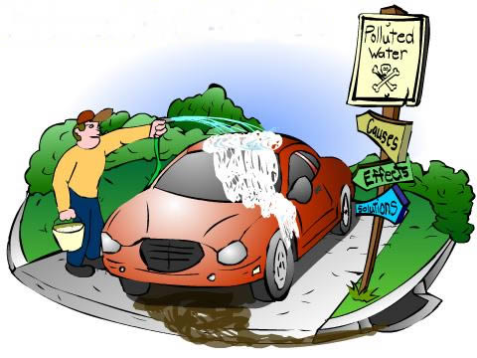
Pollution in our Watershed
Non-Point Source Pollution
Pollution that does not come from a single point or location.

Slide 29
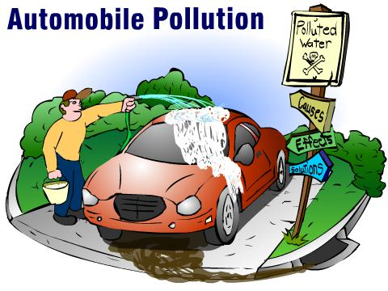
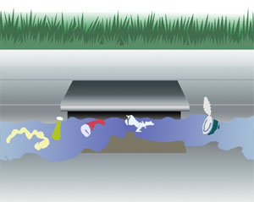
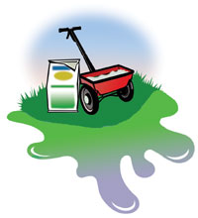
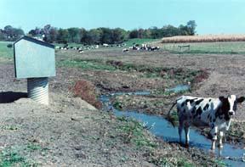
Non Point Pollution Sources
Litter
Lawn Fertilizers & Pesticides
Agricultural Runoff

Slide 30
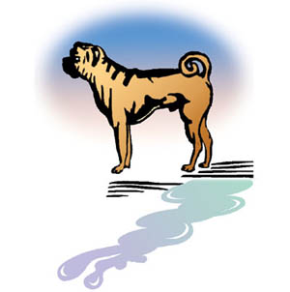

Non Point Pollution Sources
Even your DOG!!!!!

Slide 31
Pollution in our Watershed
Point Source Pollution
35%
Non- Point Source Pollution
65%

Slide 32
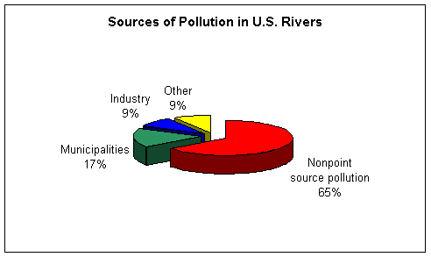

Slide 33
STEWARDSHIP
Now that you know most pollution doesn’t come from big business, but from everywhere and everyone, what can we do to help fix this serious problem?
STEWARDSHIP – Following practices that protect Earth’s resources
http://www.youtube.com/watch?v=gtcZbN0Z08c&feature=youtu.be

Slide 34
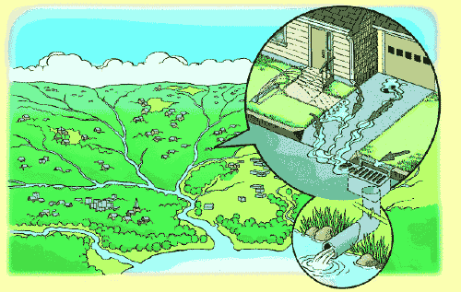

Slide 35
Protecting Watersheds:
What You Can Do Everyday
Simple Ways to Protect Your Watershed
Don’t Dump or Litter
Water and Landscape Wisely
Control the Flow
Pick up After Rover
Fix that Leak
Participate in a Cleanup

Slide 36
REMEMBER!
A CLEANER ENVIRONMENT STARTS WITH YOU!

Slide 37
Other water sources
Groundwater
Aquifer
Wetland
Estuary

Slide 38
DO YOU REMEMBER:
Where else does the water go?
What is groundwater?
  The water found in cracks and pores in sand, gravel and rocks below the earth’s surface
What is an aquifer?
  A porous rock layer underground that is a reservoir for water

Slide 39
Aquifers
The freshwater we drink often comes from aquifers
People drill wells into aquifers
Some are near the surface; others are as much as 1000 meters below the surface

Slide 40
DID YOU KNOW!
52% of the people living in NC get their drinking water from wells. Many homes even have their own individual wells!

Slide 41
Other areas of Surface Water
What is a wetland?
  An area where the water table is at, near or above the land surface long enough during the year to support adapted plant growth

Slide 42
What are the types of wetlands?
  Swamps, bogs, and marshes
    Swamp: a wetland dominated by trees
    Bogs: a wetland dominated by peat moss
    Marshes: a wetland dominated by grasses

Slide 43
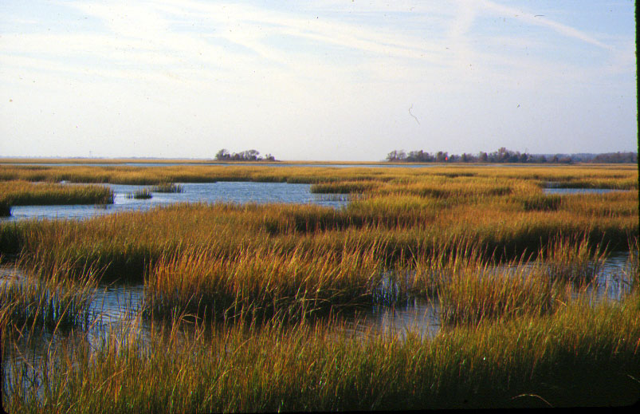
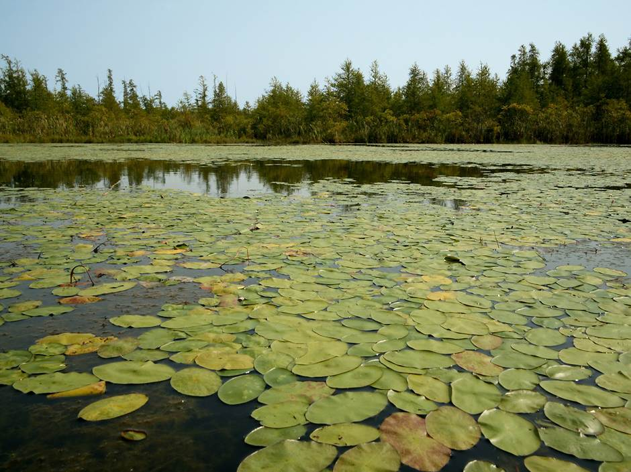
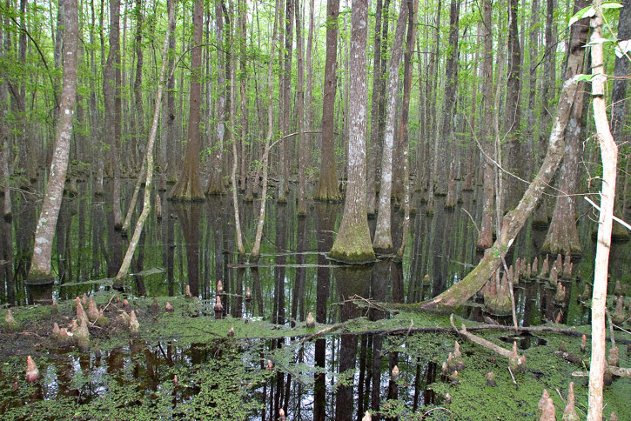
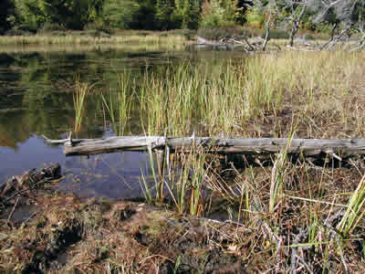
Notes:
1. Marsh 2. Bog 3. Swamp 4. Bog

Slide 44
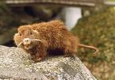
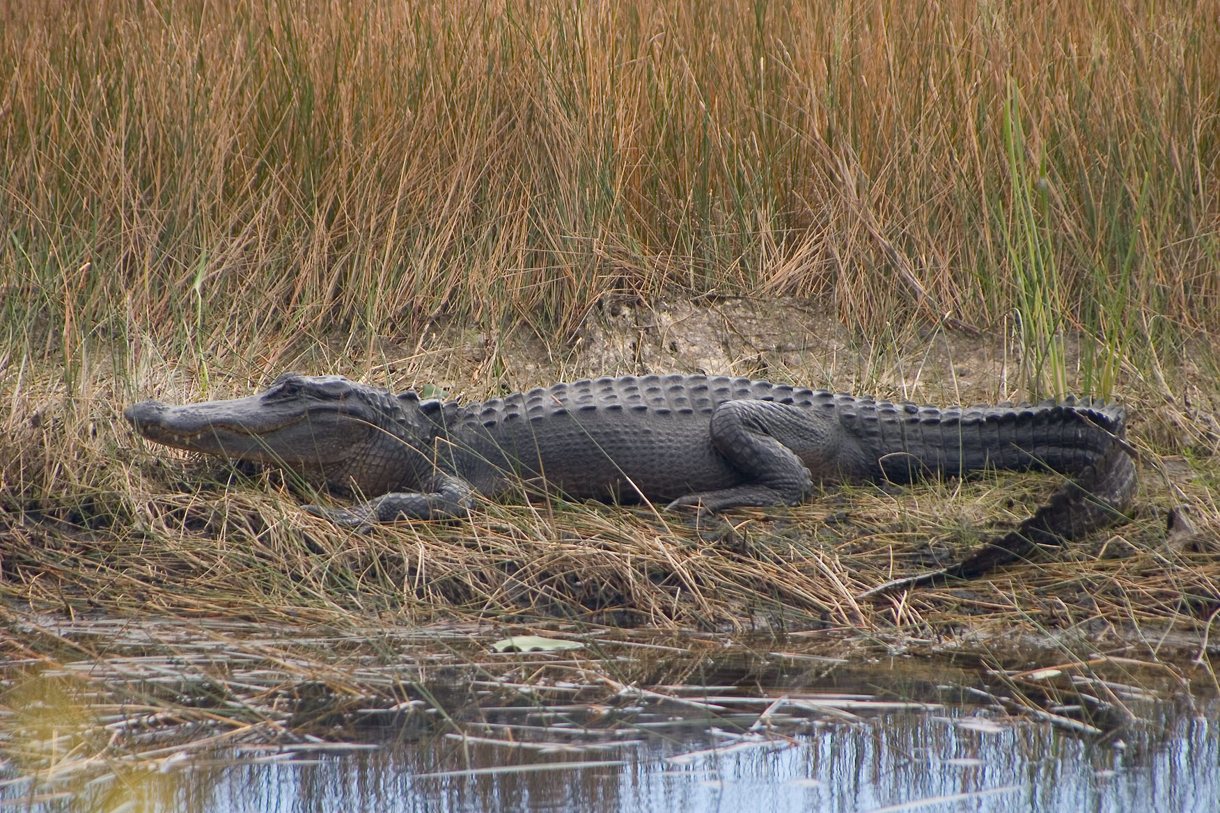
What types of animals depend on Wetlands?
  Migrating birds:
    Provide cover and resting areas during long flights.
  Mink and Muskrat
  Reptiles

Slide 45
Why are Wetlands Important?
They trap sediment:
  The trapped sediment cannot enter into lakes and streams. This keeps streams and lakes clear.
They use a lot of excess nutrients:
  Wetlands near lakes and streams use these nutrients for their plant growth. Decreasing eutrophication (ex. Algal blooms).
Wetlands provide habitats for both water and land animals.

Slide 46
Other areas of surface water - Estuaries
What is an Estuary?
A body of water in which freshwater from a river meets and mixes with salt water from the ocean
The NEUSE RIVER flows into the PAMLICO SOUND (an estuary)
The CAPE FEAR RIVER flows directly into the ATLANTIC OCEAN

Slide 47
Why do some rivers flow into the ocean and others into estuaries? What is the difference if they are all flowing into the ocean?
In estuaries, the fresh river water is blocked from streaming into the open ocean by either surrounding mainland, peninsulas, barrier islands, or fringing salt marshes.

Slide 48
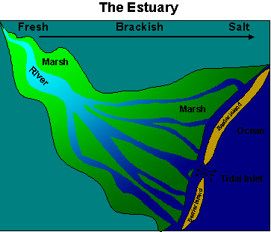

Slide 49
FAST FACT
The banks of many estuaries are amongst the most heavily populated areas of the world, with about 60% of the world's population living along estuaries and the coast.
Why do you think this happens?

Slide 50
ESTUARY INFO:
Nursery Habitats – rich in nutrients and plant life (food and places to hide)
Feeding Grounds
A lot of biodiversity
Most of our seafood comes from them (fish, shrimp, clams, crab, etc.)
Water is BRACKISH
Other names: inlets, bays, harbors, lagoons, and sounds

Slide 51
Estuary = Nursery Habitat
In North Carolina we have 2.2 million acres of estaurine habitat. This is a nutrient rich environment that supports a great diversity and abundance of aquatic life. In fact, estuaries are called nursery habitat because many marine animals, such as fish and shrimp, start out their lives as eggs and juveniles in the estuary. Others, like dolphins, sharks and sea turtles use the estuaries as feeding areas or refuges. Much of the seafood that we eat relies upon having clean and healthy estuaries.

Slide 52
Salinity
is the saltiness or dissolved salt content of a body of water or in soil.
Salinity levels vary in different parts of the ocean
Typically 3.5%
Challenge Question: Who can explain the logic behind this statement???
Salinity is lower where precipitation is higher than evaporation.

Slide 53
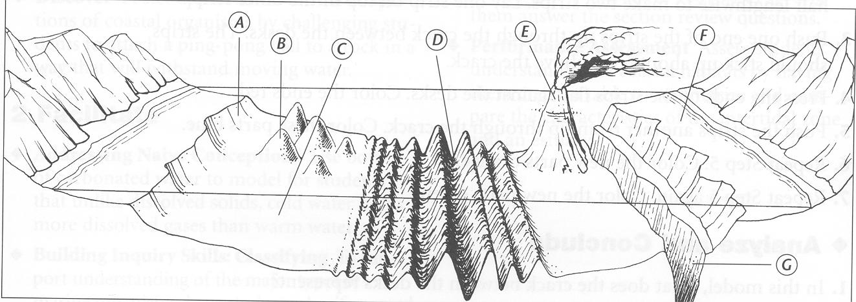
Warm Up: January 27, 2014
Name the following ocean floor features…
Features of the Ocean Floor:
B.
D.
F.
G.

Slide 54
Warm Up: January 27, 2014
The answers are…
Features of the Ocean Floor:
B.
D.
F.
G.
coral reef
mid-ocean ridge
continental shelf
trench

Slide 55
Water Quality
Scientists test water quality with thermometers and water meters
They also collect water samples to check for substances dissolved in the water, temperature of the water, and kinds of organisms that live there

Slide 56
Factors that affect water quality
Seasonal changes in temperature affect oxygen levels
Weather affects quality due to erosion during heavy rain storms
Depth of the water and speed of the currents affect the quality
Human activity (adding chemicals)

Slide 57
Physical Indicators
Dissolved Oxygen and Temperature
Colder water holds more oxygen than warmer water
As the temperature increases – The dissolved oxygen decreases
Healthy water has med. to cold water and heavily dissolved oxygen levels
If the water gets too hot, fish kills can occur (an event where a large number of fish die)
VERY IMPORTANT

Slide 58
Physical Indicators
PH
A measure of how acidic or basic a liquid is
A ph scale is numbered 0-14 / 7 is neutral
Below seven is acidic / above seven is basic
Sea water is around 8.0 or 9.0 – slightly basic
Acid rain makes water too acidic (low ph)
Too much algae makes water too basic (high ph)

Slide 59
Physical Indicators
Turbidity
A measure of how clear water is
High turbidity (cloudy water) is Unhealthy
Soil from runoff can cause high turbidity – not always permanent
Rapid growth of algae = high turbidity
Marine life need clear water so that they can get sunlight

Slide 60
Checkpoint Trivia
What does a pH of 7 most likely indicate about water quality?
  The water is a strong base.
  The water is highly acidic
  The water is toxic to drink.
  The water is safe to drink
What does pH measure?
  Acidity/alkalinity
  Dissolved oxygen
  Nutrient level
  Turbidity

Slide 61
Checkpoint Trivia
Which change indicates a decrease in the pH of a body of water?
  The water becomes turbid.
  Large organisms begin to die.
  Dissolved oxygen levels increase.
  Aquatic plants increase in numbers.
Which would be the most likely cause of large numbers of fish dying in a stream?
  A lack of nitrogen
  High levels of mercury
  Decreased carbon dioxide
  Low dissolved oxygen concentration

Slide 62
Chemical Indicators of unhealthy water
High levels of nitrates and phosphates (found in fertilizers) = algal blooms
Algal bloom – extremely rapid growth of algae
They block sunlight can cause high turbidity
Example: Pfiesteria (found in NC) is poisonous

Slide 63
Eutrophication
The process where water bodies receive excess nutrients like nitrates and phosphates that stimulate excess plant growth

Slide 64
Dead Zones
When algae and other aquatic plants grow in large numbers, they use up all of their resources and die off. As decomposers break down their remains, they use up a lot of oxygen. As oxygen levels get low, other marine life die. This is called a low oxygen DEAD ZONE. The dead algae sinks to the bottom of the ocean, where the oxygen can’t be replaced easily due to lack of sunlight.

Slide 65
Checkpoint Trivia
Which water quality data most likely indicates eutrophication?
  pH level
  Turbidity
  Temperature
  Nutrient level
If a large amount of fertilizer enters a lake, which will most likely happen?
  The fish population in the lake will increase
  The temperature of the lake water will increase
  The number of fish dying in the lake will increase
  The available food supply for the fish in the lake will increase

Slide 66
Checkpoint Trivia
How do phosphate detergents contribute to water pollution?
  By killing plant life
  By stripping the oil from bird feathers
  By over-fertilizing plants in the water
  By removing carbon dioxide from the water
How do nitrate levels affect the health of a water system?
  As the nitrates decrease, there is an increase in plant growth.
  Nitrates cause bacteria to consume large protein molecules
  Nitrates cause aquatic organisms to die due to oxygen depletion
  As nitrates increase, there is an increase in dissolved oxygen levels

Slide 67
February 17, 2014- Warm Up
What is usually the cause of algal blooms? (Be specific)
What do we call an area of freshwater mixing with salt water?

Slide 68
Biological Indicators
Bioindicators – organisms used to monitor the health of an ecosystem
EX: fish require a lot of oxygen – a lot of trout would mean healthy water
A lot of diversity = healthy water
A lot of Insect Larvae = clean water
BUT Blackfly larvae = polluted water because they can handle the polluted water

