Slide 1
Earth’s Water

Slide 2
Our “Blue” Planet

Slide 3
~97% of Earth’s water is saltwater (water that has salt in it)
~3% of Earth’s water is freshwater (water that does not contain any salt)

Slide 4
Oceans
Earth has 4 named Oceans: Atlantic, Pacific, Indian, and Arctic
All of Earth’s oceans are connected

Slide 6
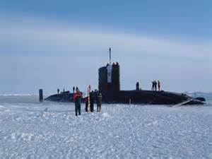
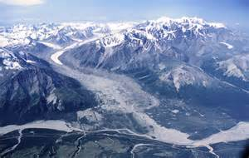
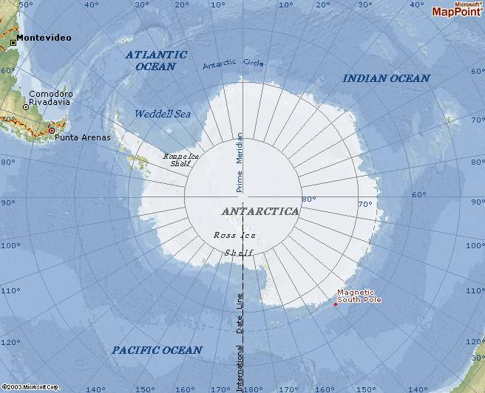
Solid:
- “Frozen” freshwater can be found in icebergs, glaciers, ice caps North and South Poles

Slide 7
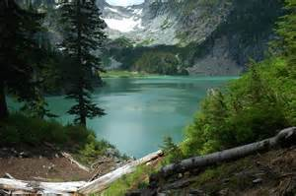
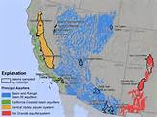
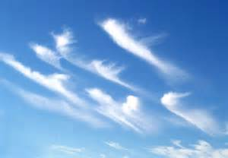
Free-flowing:
Free-flowing water can be found in:
Rivers/lakes
Swamps/ Marshes
Ground/Aquifer
Animals
Plants
Atmosphere

Slide 8
Earth’s Water:
97% 3%
(saltwater/oceans) (freshwater)
70% 30%
(Solid) (free-flowing)
- No Pole - Underground
- So Pole - Aquifers
- Icebergs - Rivers
- Glaciers - Lakes
- Ice caps - Animals
- Plants
- Atmosphere

Slide 9
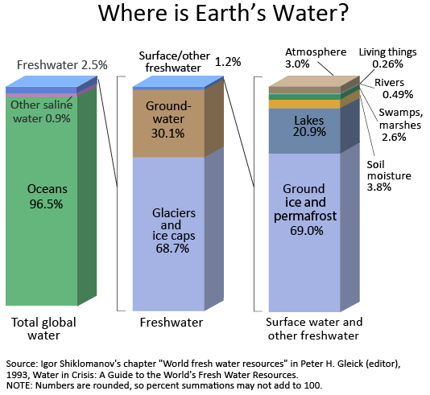

Slide 10
Interesting Facts about Water:
Human bodies are 2/3 water
Human brain is 80% water
Humans can live longer without consuming food as compared to consuming water
If a human loses 20% of their total body water, they are unable to survive

